Slide 1
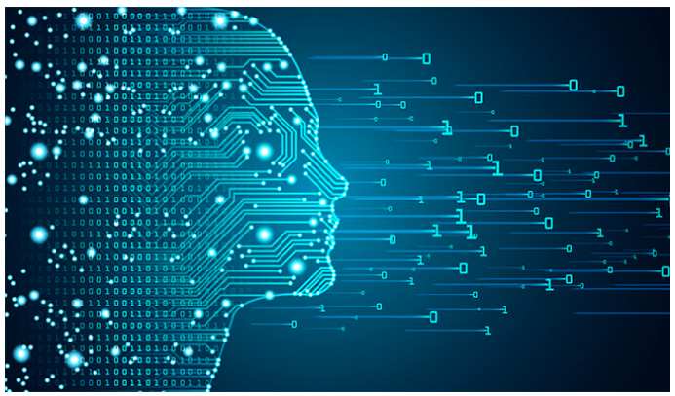
Deep Learning
Dee
Session -10: RNN

Slide 2
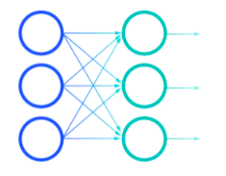
FFNN

Slide 3
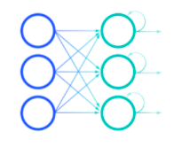
RNN- Recurrent Neural Networks

Slide 4
Sequence learning
Data: Tabular data (Eg: csv) or image
These are stationary
However there are sequence data
Eg: Stock market data, Video data, Text data, Audio data, Speech
Even human behavior : Sequential.

Slide 5
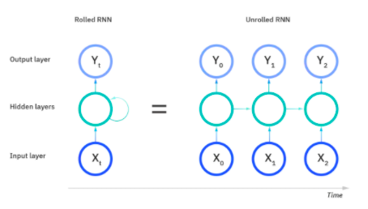
RNN
Used for sequential data or time series data.
Previous values can be stored as ‘memory’.

Slide 6
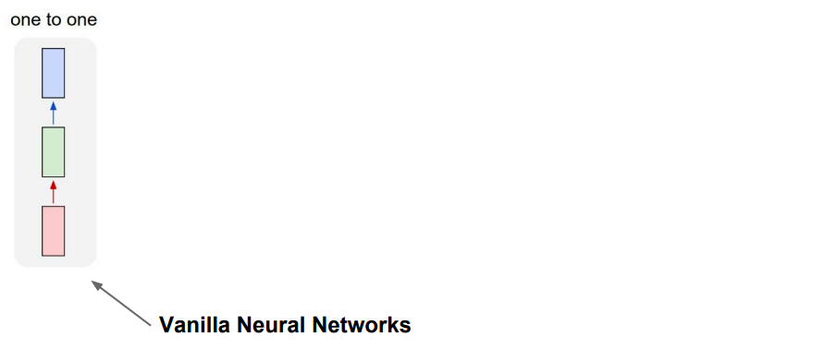
Different types of RNN

Slide 7
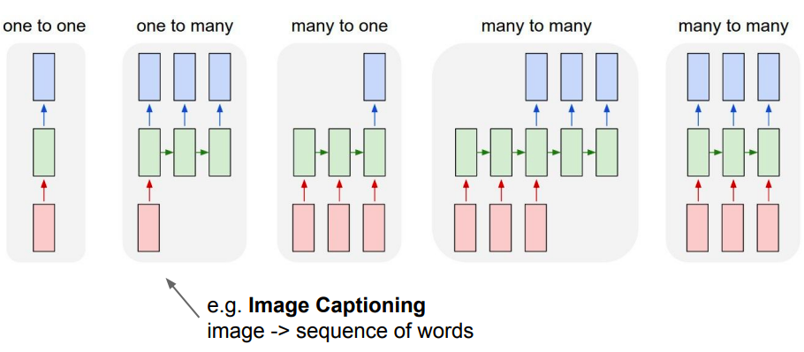
Different types of RNN

Slide 8
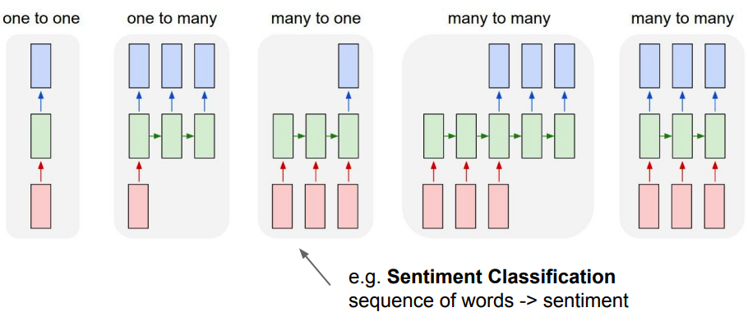
Different types of RNN

Slide 9
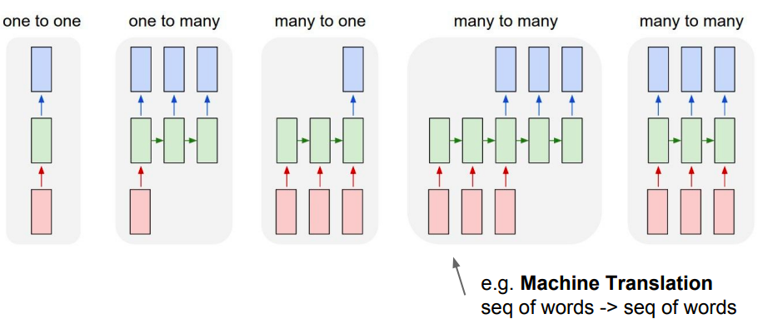
Different types of RNN

Slide 10
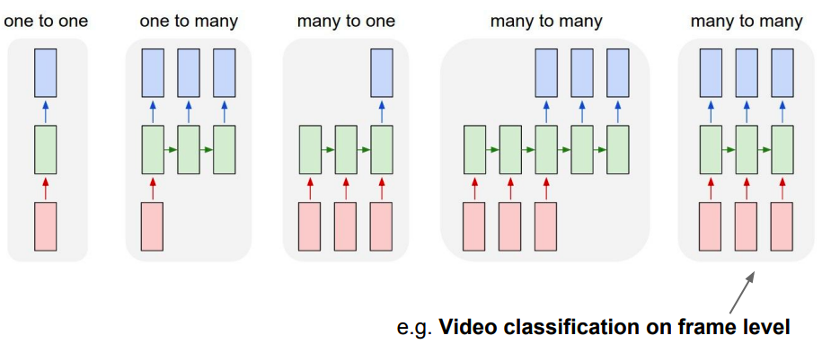
Different types of RNN

Slide 11
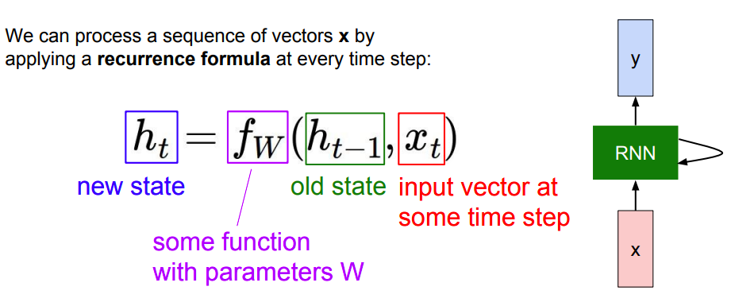

Slide 12
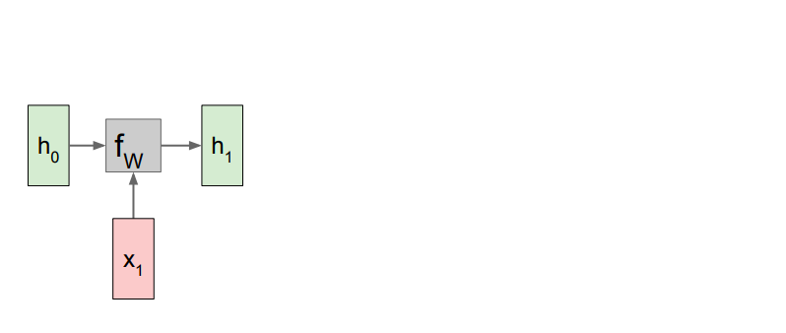

Slide 13
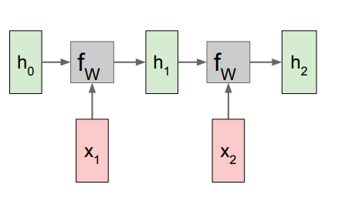

Slide 14
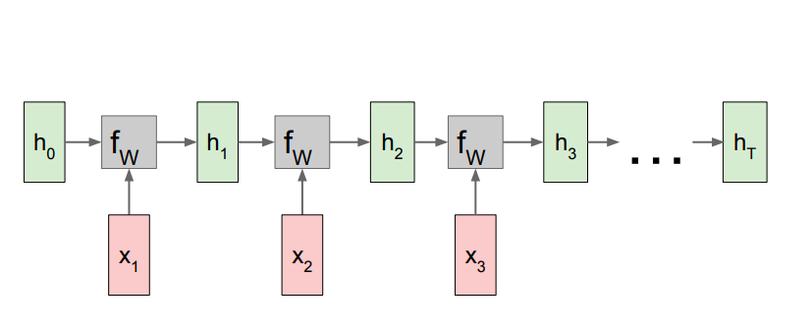
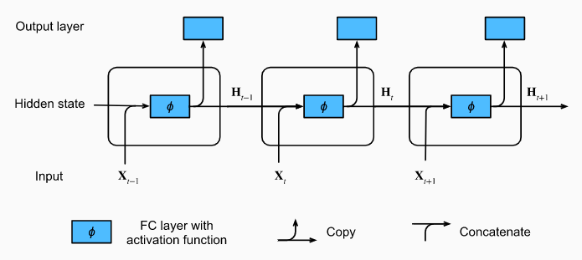

Slide 15
Converting a sequence problem to ML problem

Slide 16
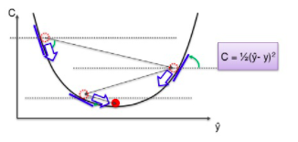
Issues with RNN
Vanishing gradient: slope of the loss function becomes very small or zero➔ No learning happening.
Exploding gradient: Slope is very large, model become unstable

Slide 17
RNN Architecture
LSTM: Long Short Term Memory Network
GRU: Gated Recurrent Units
Bidirectional RNN

Slide 18
LSTM
Uses cells in hidden layer with four gates, which control the flow of info:
Input gate
Output gate
Forget gate
Update

Slide 19
GRU
A particular type of LSTM

Slide 20
Refer:
https://colah.github.io/posts/2015-08-Understanding-LSTMs/

Slide 21
https://stanford.edu/~shervine/teaching/cs-230/cheatsheet-recurrent-neural-networks

